Slide 1
EXECUTIVE SALES & REVENUE PERFORMANCE ANALYSIS
Name:- PRASHIK GAWAI
MENTOR :- ASHISH RAJPUT
PROJECT TYPE :- POWER BI

Slide 2
Introduction
Sales analysis helps businesses understand revenue, profit, and customer performance through data-driven insights.
Power BI transforms raw sales data into interactive visual reports for better decision-making.
This project analyzes sales, profit, products, customers, and regional performance.
Data visualization simplifies complex business information.
AI-powered visuals help identify important business trends and drivers.

Slide 3
DATASET SOURCE
Dataset Source: Retail Sales Dataset
Number of Records: 200 , Number of Customers: 200 , Number of Orders: 200
Columns Include:
  Order Date
  Customer Name
  Product Name
  Category
  Region
  Sales
  Profit
  Quantity
  Segment
About Data
Contains customer purchase information.
Used for sales and profitability analysis.
Supports business performance reporting.

Slide 4
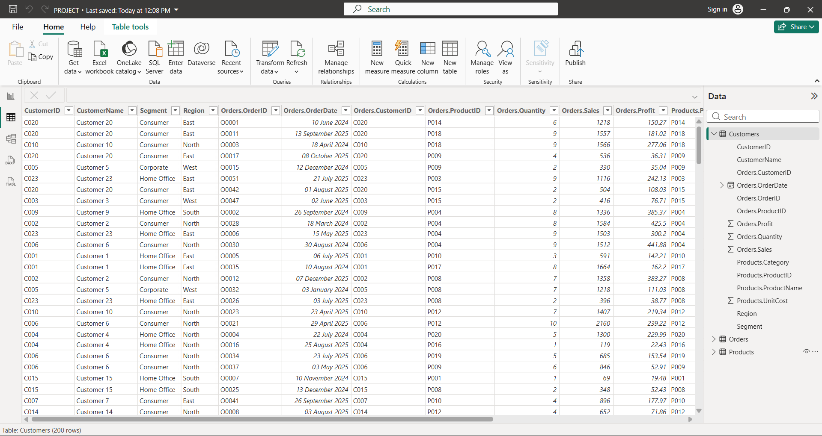
DATASET SOURCE (CONT’D)

Slide 5
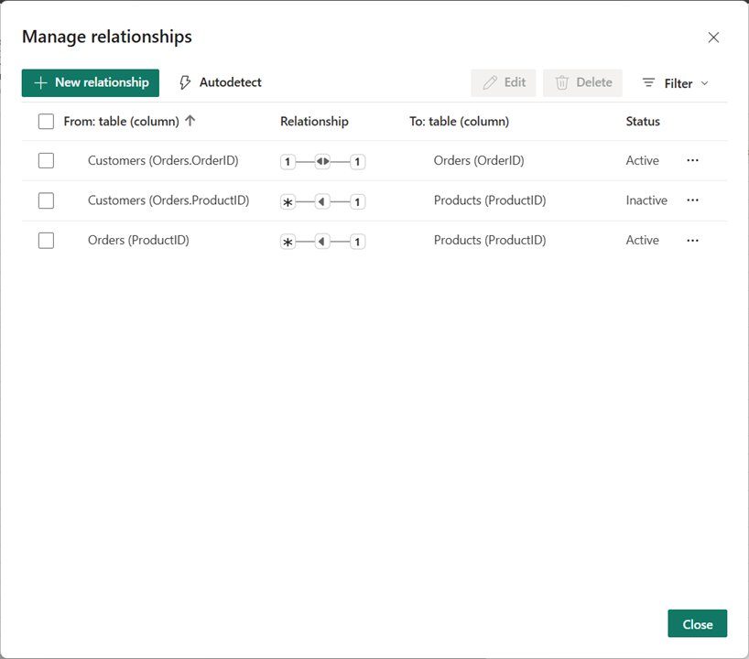
DATASET SOURCE (CONT’D)

Slide 6

OBJECTIVES & TASKS
Objective No. | Objectives | Tasks
1 | Sales Performance Analysis | 1.1 Calculate Total Sales , Profit , Margin% 1.2 Analyze Sales Trends Over Time
2 | Product Performance Analysis | 2.1 Identify Products with Highest Sales 2.2 Analyze Product Profitability 2.3 Compare Product Performance
3 | Regional Performance Analysis | 3.1 Compare Regional Sales 3.2 Analyze Regional Profit Contribution 3.3 Visualize Geographic Performance
4 | Customer Segment Analysis | 4.1 Analyze Sales by Segment 4.2 Determine Profit by Segment 4.3 Identify High-Value Customer Groups
5 | AI Insights Analysis | 5.1 Identify Key Profit Drivers 5.2 Generate Smart Narrative Insights 5.3 Use Q&A Visual for Business Queries

Slide 7
PROJECT FLOW
Data Collection
↓
Data Cleaning
↓
Data Modelling
↓
DAX Measures Creation
↓
Data Visualization
↓
Interactive Dashboard Creation
↓
AI Insights Generation

Slide 8
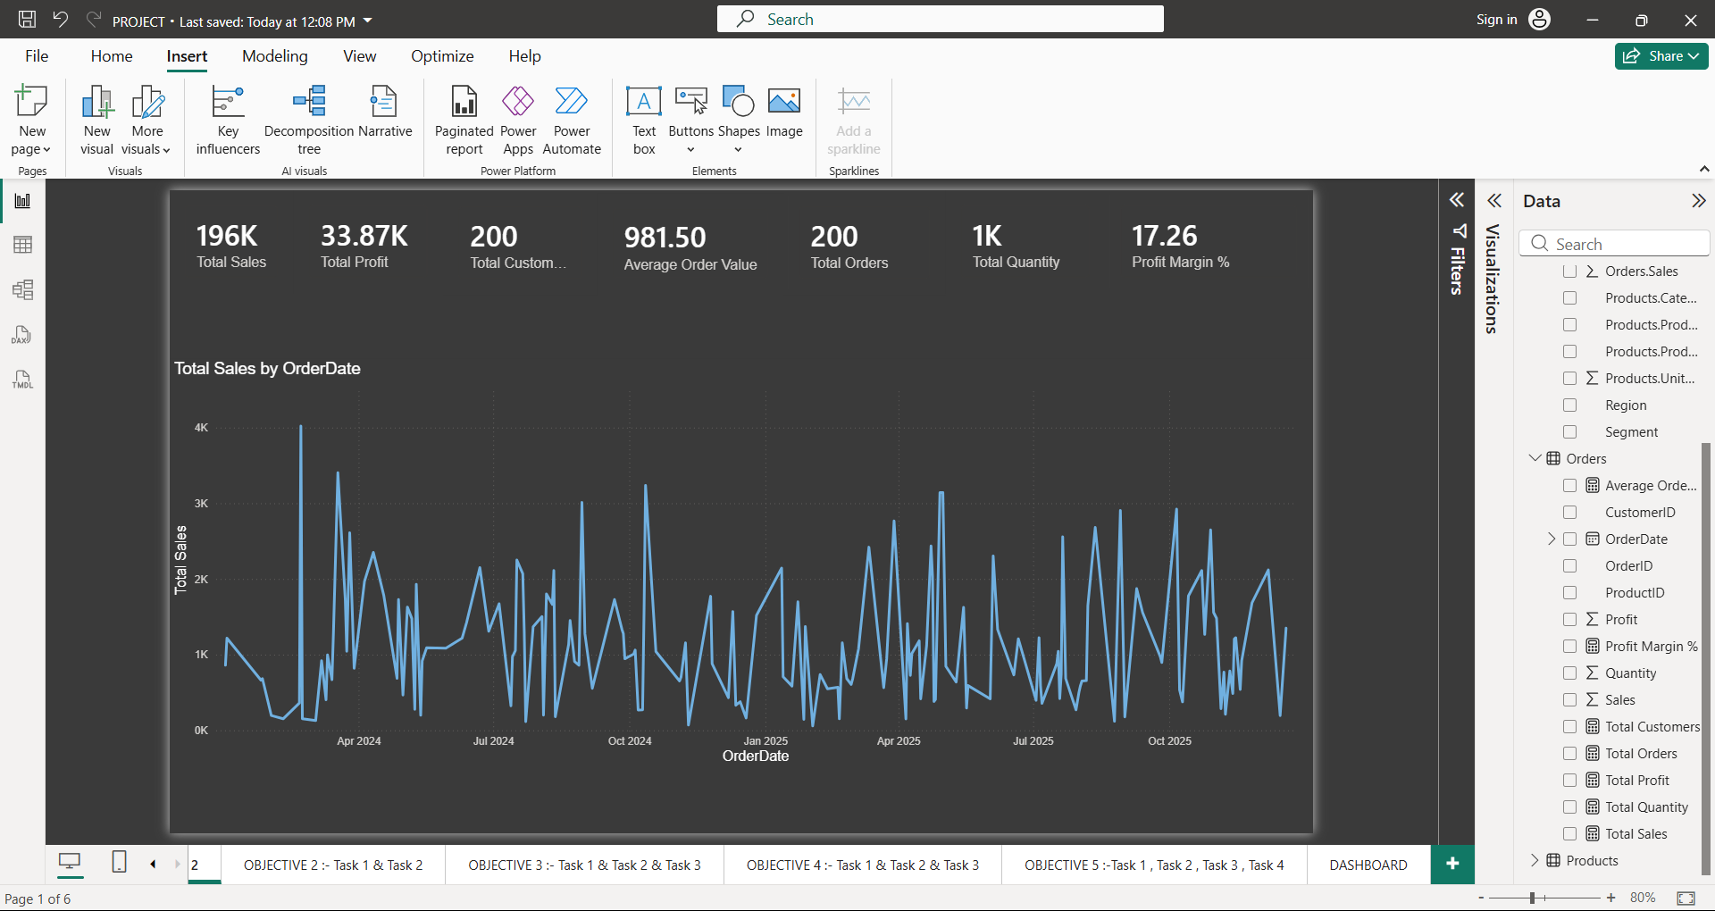
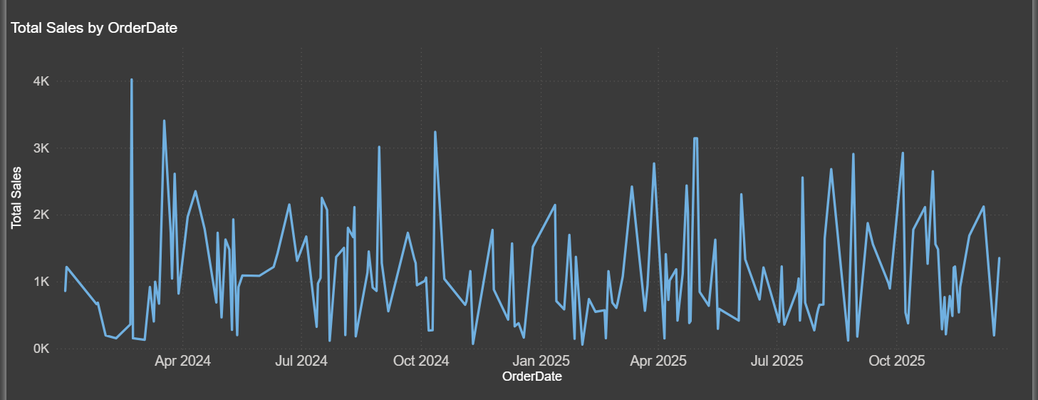
OBJECTIVE 1 :- SALES PERFORMANCE ANALYSIS
Task 1 :- Analyze Total Sales , Profit using DAX
Task 2 :- Analyze Sales Trends Over Time
The business generated strong sales of 196K and profit of 33.87K, while sales trends over time reveal fluctuations in customer demand that influenced overall performance.

Slide 9
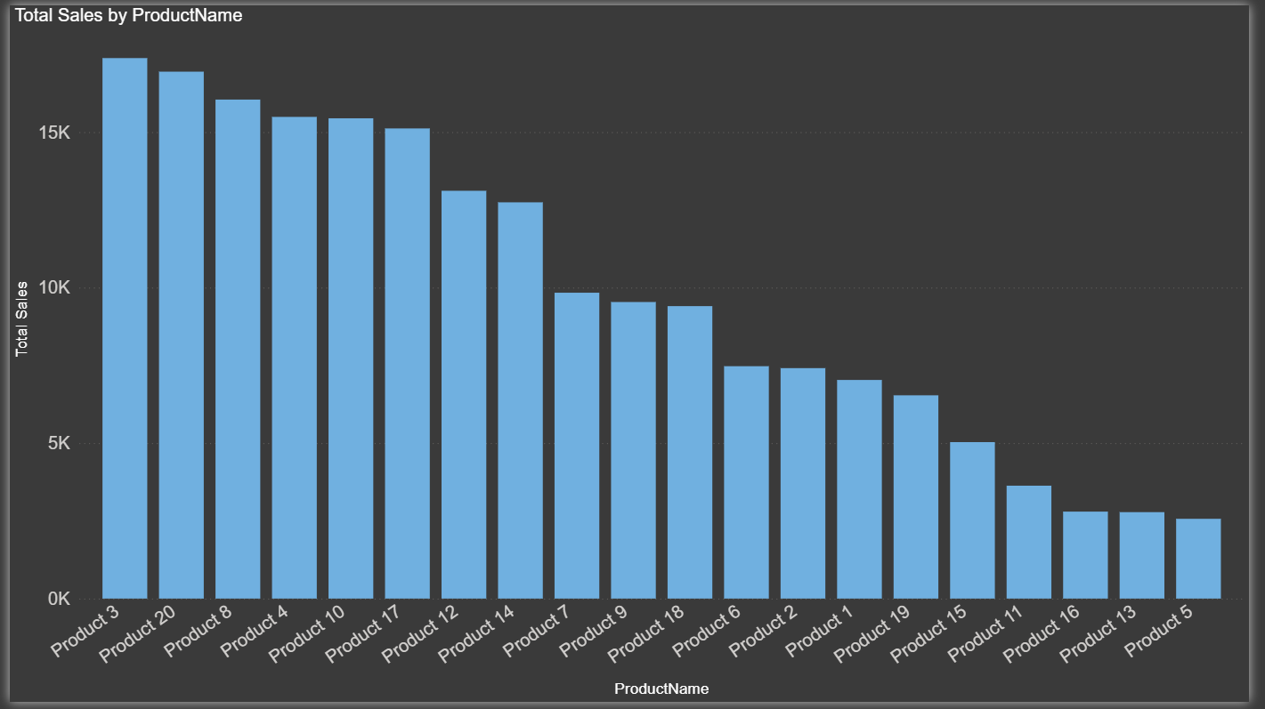
OBJECTIVE 2 :- PRODUCT PERFORMANCE ANALYSIS
Task 1: Identify Product with Highest Sales
Product 3 is the highest-selling product, contributing the largest share of total revenue and serving as a key driver of business growth.

Slide 10
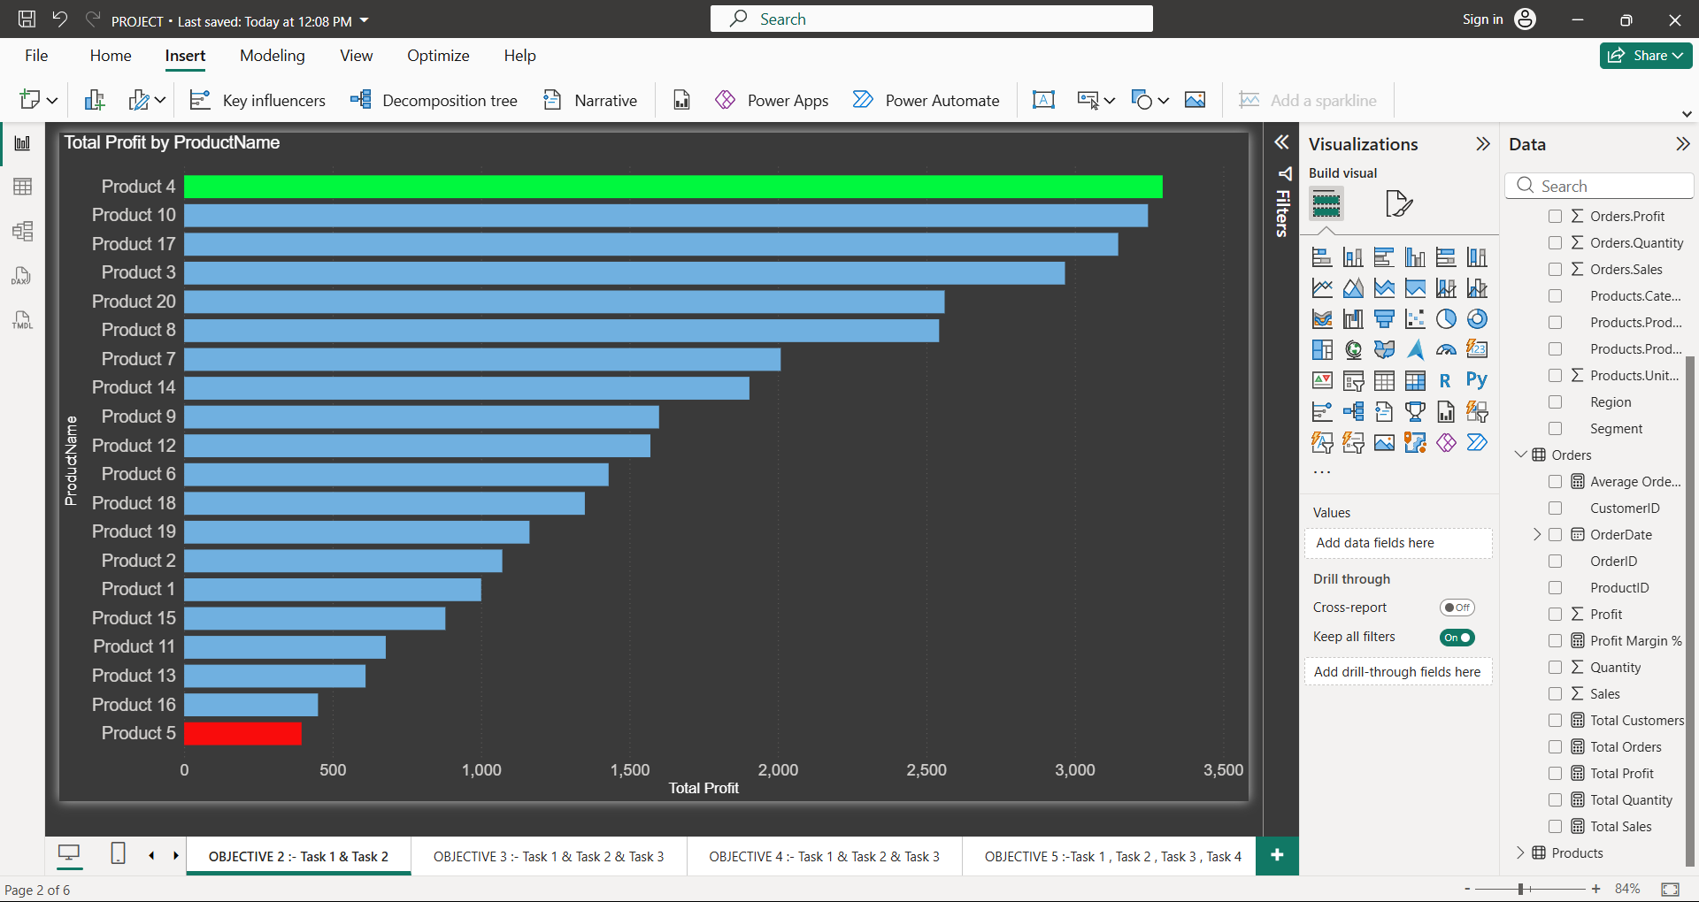
OBJECTIVE 2 :- PRODUCT PERFORMANCE ANALYSIS (CONT’D)
Task 2 :- Analyze Product Performance
Product 4 generates the highest profit, making it the strongest contributor to business profitability, while Product 5 contributes the least profit and may require performance improvement strategies.

Slide 11
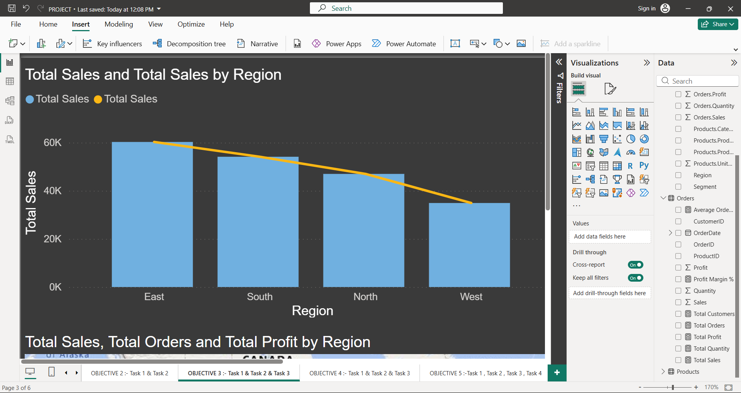
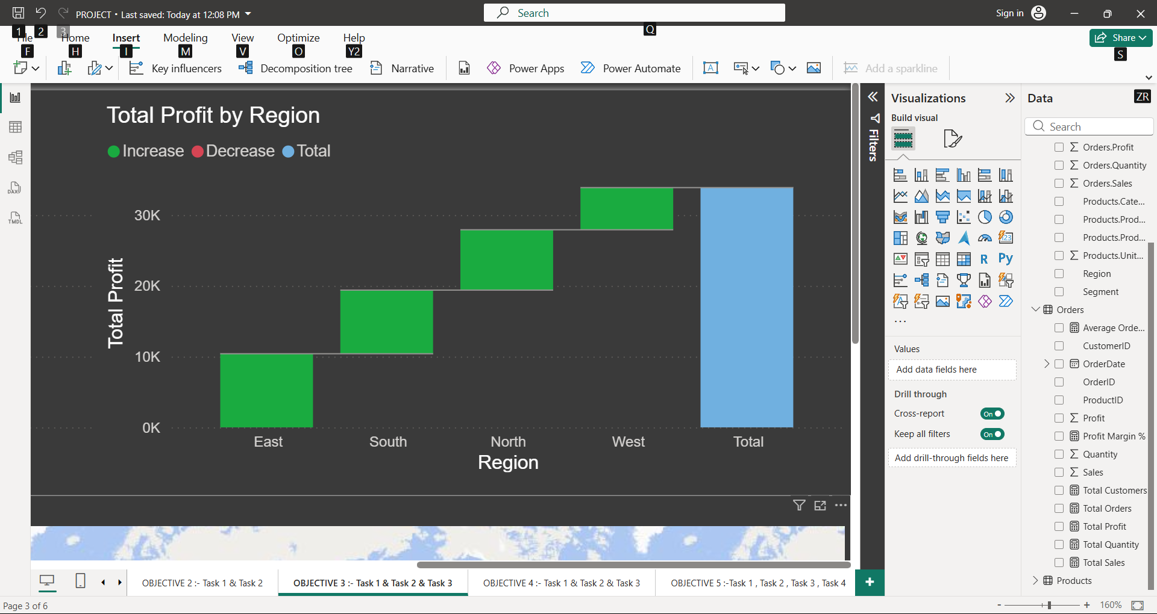
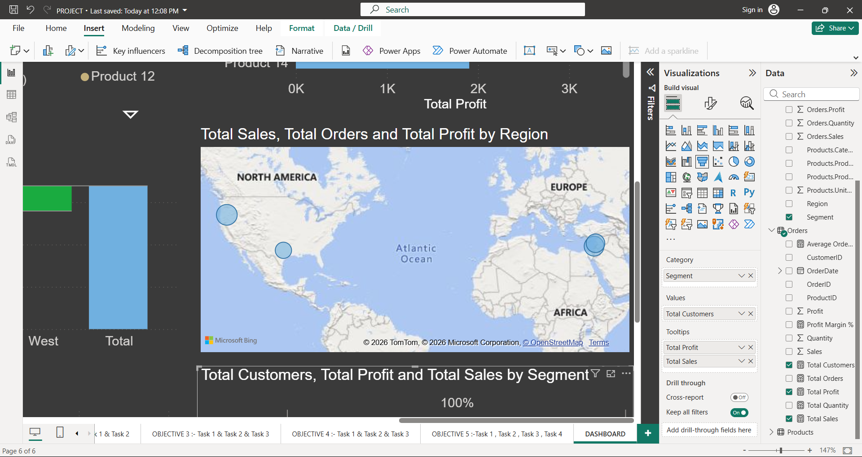
OBJECTIVE 3 :- Regional Performance Analysis
Task 1: Compare Regional Sales
Task 2 : Identify Strongest Performing Region
The East region generates the highest sales and profit, making it the strongest-performing region, while the West region contributes the least, indicating opportunities for growth and improvement.

Slide 12
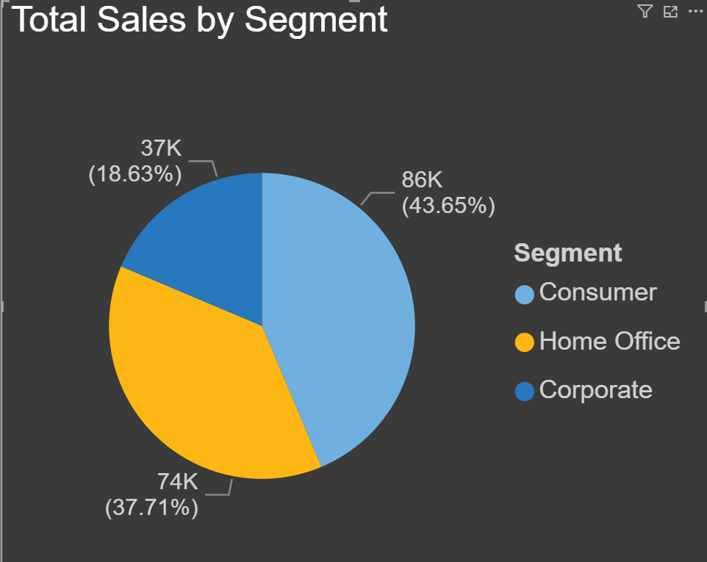
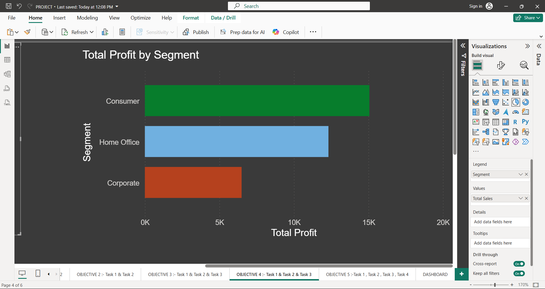
OBJECTIVE 4 :- CUSTOMER SEGMENT ANALYSIS
Task 1 :- Analyze Sales by Segment
Task 2 :- Determine Profit by Segment
Sales and profit analysis reveal that the Consumer segment is the most profitable and highest-performing segment, while the Corporate segment contributes the least to the overall business growth

Slide 13
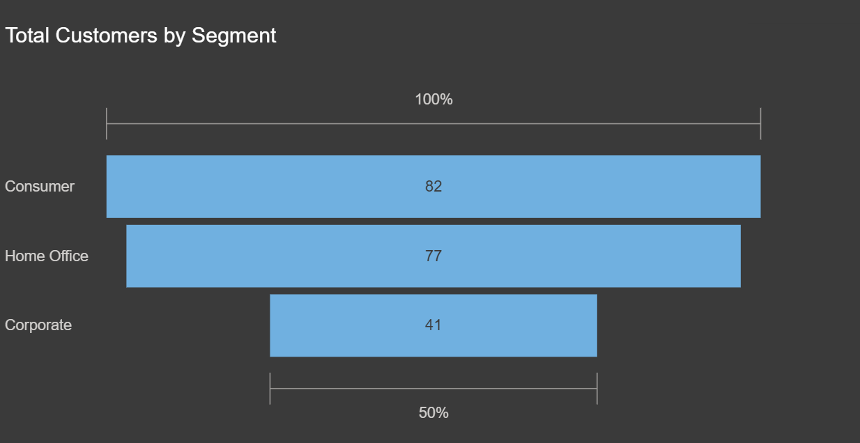
OBJECTIVE 4 :- CUSTOMER SEGMENT ANALYSIS (CONT’D)
Task 3 :- Identify High-Value Customer Groups
Consumer and Home Office segments contribute the majority of customers, making them the most valuable customer groups, whereas the Corporate segment has the lowest customer presence.

Slide 14
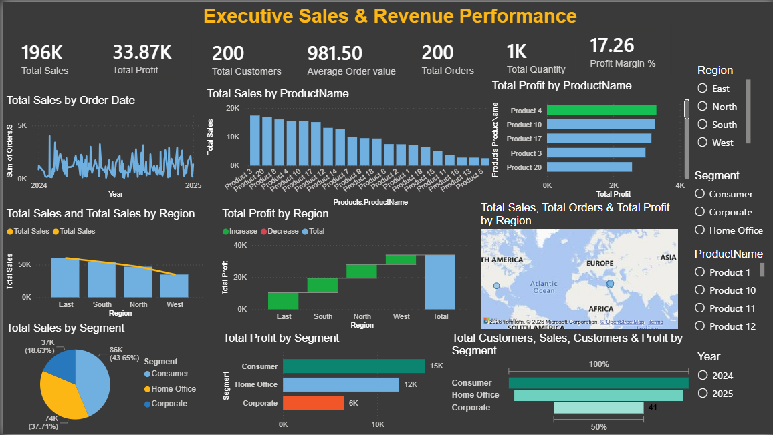
DASHBOARD

Slide 15
SUMMARY
The business generated strong sales and maintained healthy profitability throughout the analysis period.
Product 4 was the highest-performing product, while Product 5 was the lowest-performing product in terms of profit contribution.
The East region achieved the highest sales and profit, making it the strongest-performing region.
Consumer customers contributed the largest share of sales and profit compared to other customer segments.
Sales and profit performance varied across products, regions, and customer groups, highlighting key business trends.
A small number of products and regions contributed a significant portion of overall business performance.
Customer demand remained consistent across the period, supporting stable business growth and revenue generation.
Overall, the analysis identifies top-performing products, customer segments, and regions, helping the business make better strategic decisions and focus on future growth opportunities.

Slide 16

Limitations & challenges
The analysis is based on a limited dataset and may not represent all business situations.
Customer preferences and market conditions may change over time, which can affect future results.
Some external factors that influence business performance are not included in the analysis.
The findings depend on the accuracy and completeness of the available data.
The insights should be used as a guide for decision-making rather than as exact predictions of future performance.

Slide 17
CONCLUSION
The business achieved strong overall performance through sales across different products, customers, and regions.
A few products and regions contributed more to business success, showing where customer demand is strongest.
Customer buying patterns vary, making it important to understand what customers prefer most.
Identifying top-performing and low-performing areas helps the business focus on growth opportunities.
Overall, the analysis provides valuable insights that can support better planning, improved performance, and future business growth.

Slide 18
THANK YOU

